Slide 1
detector
x: position
I: current
u: voltage
electromagnet

Slide 2
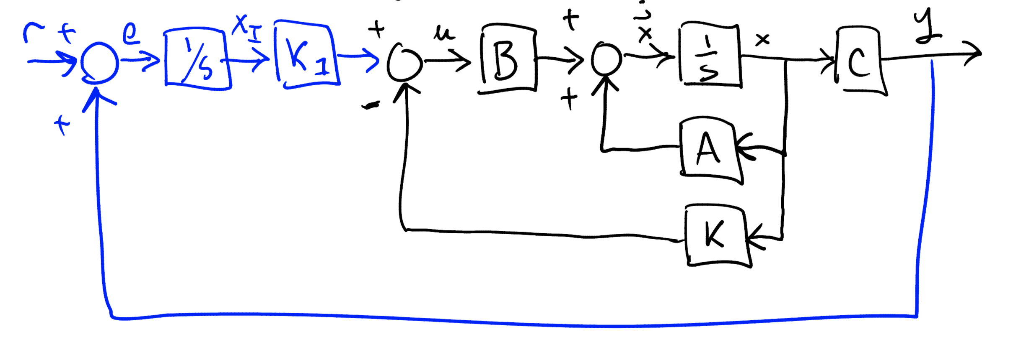
-

Slide 7
p₁₂
c₁
c₂
q₁₂
p₁₃
q₁₃
c₃

